Slide 1

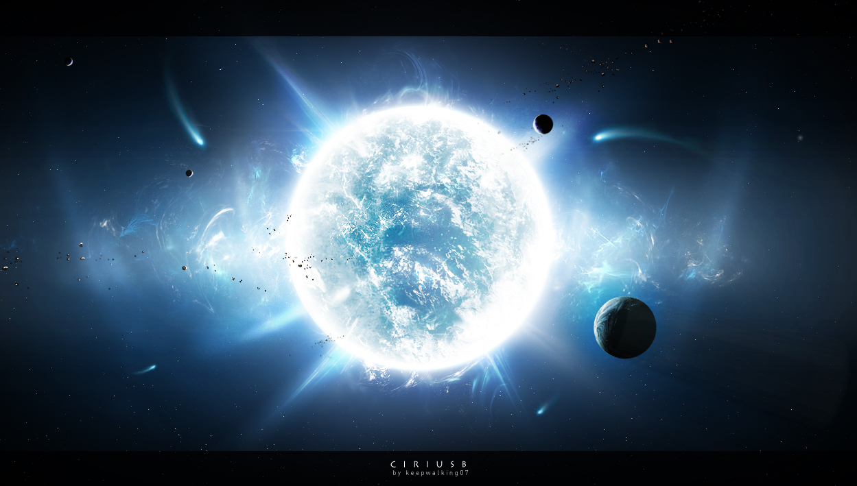
Discovering
Stellar
Secrets

Slide 2
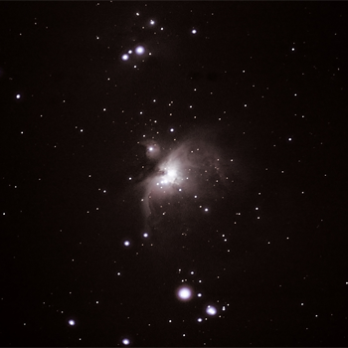
Orion Nebula (M42)
Through the Telescope

Slide 3
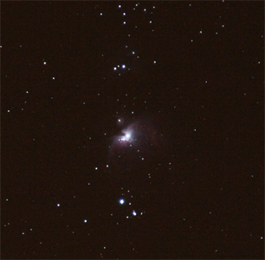
Orion Nebula (M42)
Through Binoculars
Through binoculars, the interstellar gas and dust that makes up the nebula appears as a small fuzzy spot.

Slide 4
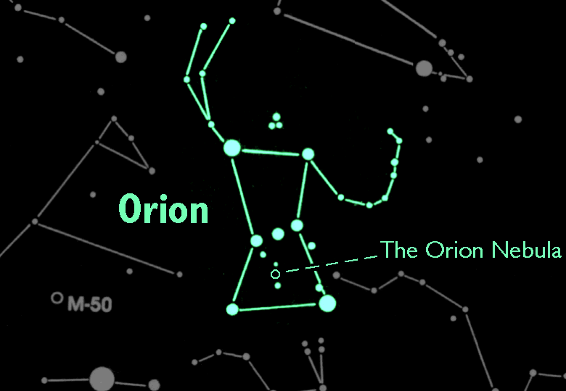
Orion Nebula (M42)
In the Night Sky
M42 is the middle 'star' in the sword of Orion the Hunter

Slide 5
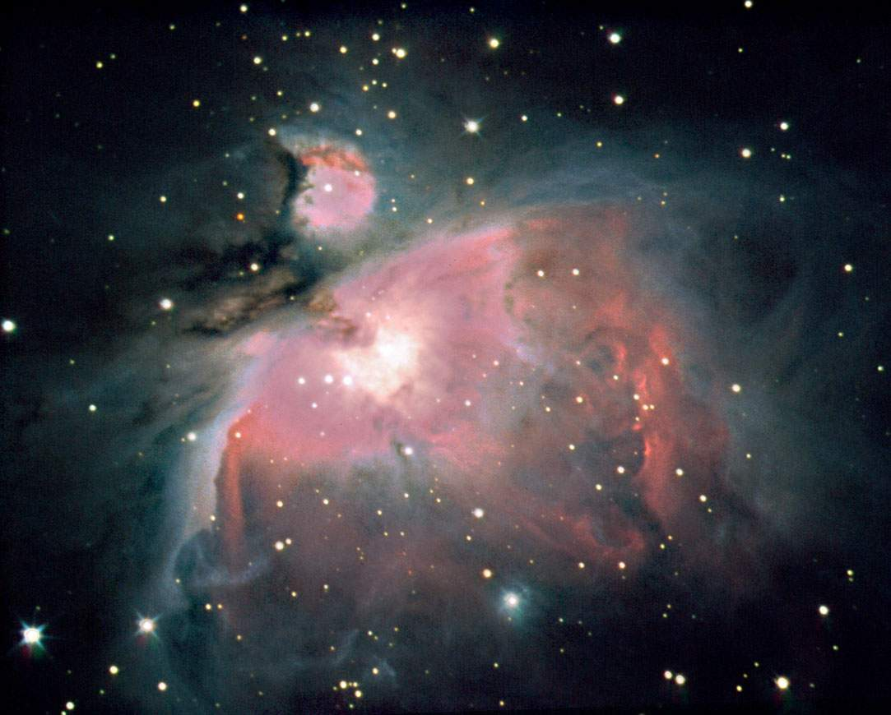
Diffuse Nebulae
M42 is an example of a diffuse nebula - a cloud of gas and dust from which new stars are being born.

Slide 6
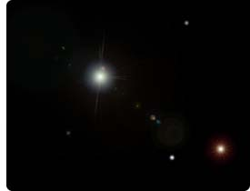
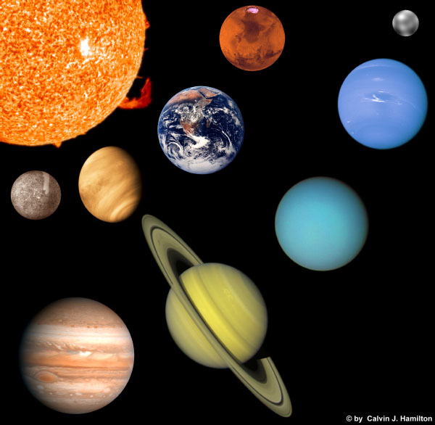

Diffuse Nebulae
The density of the nebula is a better vacuum than any vacuum we can create here on Earth.
A piece of the nebula the size of the earth has only enough material to fit in a thimble.

Slide 7
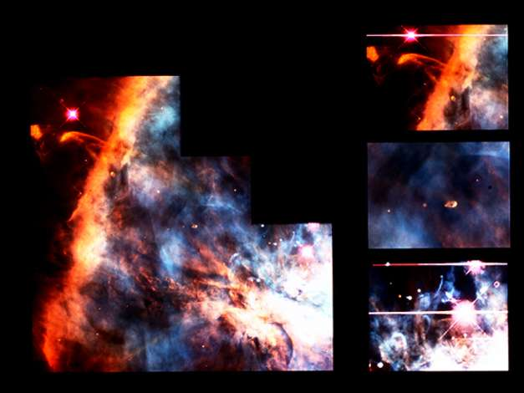
Diffuse Nebulae
Over the course of a few hundred thousand or million years, the cloud will break up into 100-200 smaller clouds, each of which will eventually condense into young proto-planetary discs called proplyds.

Slide 8
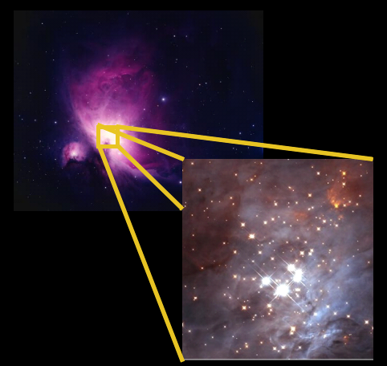
The Trapezium
Within the Orion Nebula there are over 1,500 young stars, dominated by the four brightest.
These four bright stars, called the ‘Trapezium’, illuminate the rest of the nebula making it visible to us.

Slide 9
The Trapezium
The Intense radiation from the young hot stars is blowing the colder clouds of hydrogen away.
This process is called photoevaporation.

Slide 10
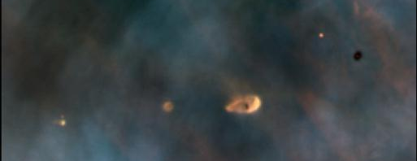
Young Star Formation
proplyds
This Hubble Space Telescope image of a small portion of the Orion Nebula reveals five young stars surrounded by gas and dust trapped in orbit as they formed.

Slide 11
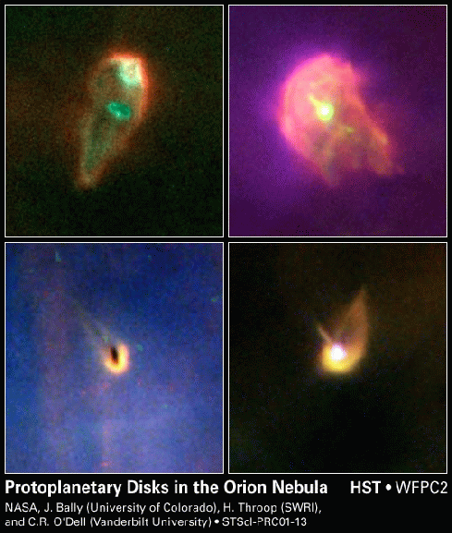
Stellar Disks
Flattened ovals can be seen in diffuse nebulae. They are thought to be new solar systems forming around young stars called "protoplanetary disks“ or proplyds.

Slide 12
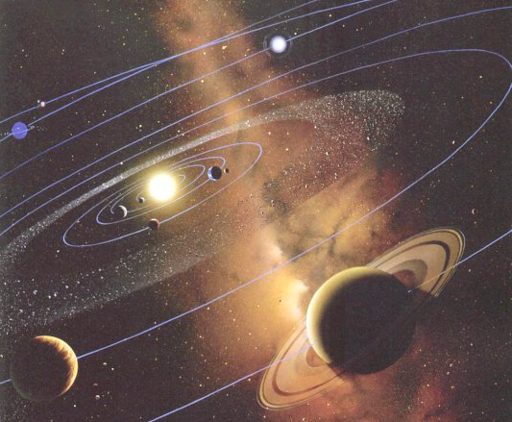
Solar Systems
Eventually, these protoplanetary disks will become solar systems, some may even become similar to our own.

Slide 13
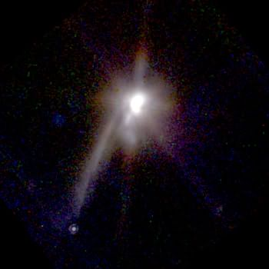
Binary Star and Planet Formation
In 1998, the Hubble Space Telescope observed this process in a new binary star system. It has a lane of dust pointing to a new Jupiter-sized planet.
In millions of years the dust will collapse into additional smaller planets or fall into the stars.
New proto-planet

Slide 14
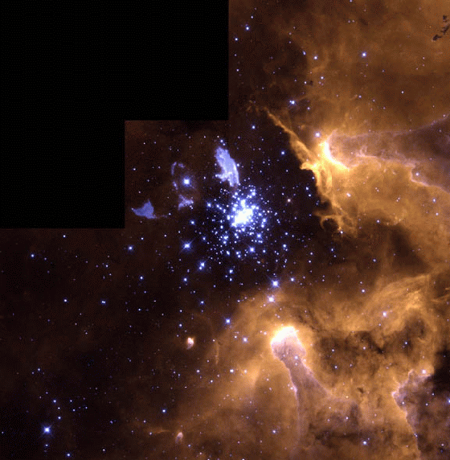
Star Clusters
This HST image shows a new star cluster emerging from a nebula.

Slide 15
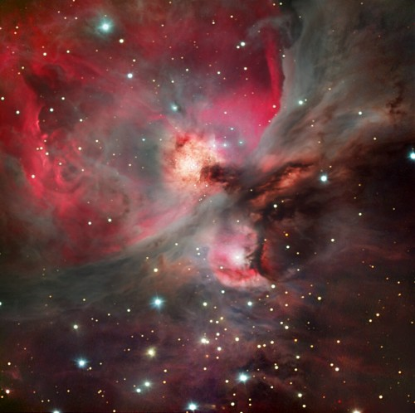
Our sun formed out of a nebula similar to M42 about 5 billion years ago.
Birth of a Star

